Slide 1

MIT School of Engineering, Pune
Department of Computer Science & Engineering
“Xboard: An Secure Keyboard”
Group No.: 02
Roll No. | Div. | Enrollment No. | Name of Student
2203514 | NS | MITU20BTCSD035 | Tanmay Joshi
2196068 | NS | MITU19BTML0023 | Rohan Bhange
Roll No. | Div. | Enrollment No. | Name of Student
2203514 | NS | MITU20BTCSD035 | Tanmay Joshi
2196068 | NS | MITU19BTML0023 | Rohan Bhange
2193114 | NS | MITU19BTCS0105 | Himanshu Gupta
2193067 | NS | MITU19BTCS0044 | Avishi Bafna

Slide 2

Flow Of Presentation
Introduction
Literature Survey
Problem Statement
Abstract
Scope of Project
Technical Compatibility
Social aspect of Project
Implementation
Future Scope and Enhancements
Conclusion
‹#›

Slide 3
Introduction
Our project focuses on creating a secure keyboard which deals with the issues of privacy, data breach.
X Board is designed to meet today’s need for a light-weight, Internet-scale data protection solution for mobile devices.
Beyond its appearance and flexible features it will be equipped with the security feature unlike no other keyboards promises in the market.
‹#›

Slide 4
Literature Survey
Sr. No. | Title | Advantages
1. | Encrypted Keyboard | To protect users from numerous password inference attacks, we invent a novel context aware privacy enhancing keyboard (PEK) for Android touch-based devices. Usually PEK would show a QWERTY keyboard when users input text like an email or a message. Nevertheless, whenever users enter a password in the input box on his or her touch-enabled device, a keyboard will be shown to them with the positions of the characters shuffled at random. PEK has been released on the Google Play since 2014. However, the number of installations has not lived up to our expectation. For the purpose of usable security and privacy, we designed a two-stage usability test and performed two rounds of iterative usability testing in 2016 and 2017 summer with continuous improvements of PEK. The observations from the usability testing are educational: (1) convenience plays a critical role when users select an input method; (2) people think those attacks that PEK prevents are remote from them.
2. | Using Biometrics | We present a data logging concept, tool, and analyses to facilitate studies of everyday mobile touch keyboard use and free typing behaviour: 1) We propose a ﬁltering concept to log typing without recording readable text and assess reactions to ﬁlters with a survey (N=349). 2) We release an Android key-board app and backend that implement this concept. 3) Based on a three-week ﬁeld study (N=30), we present the ﬁrst analyses of keyboard use and typing biometrics on such free text typing data in the wild, including speed, postures, apps, auto correction, and word suggestions. We conclude that research on mobile keyboards beneﬁts from observing free typing beyond the lab and discuss ideas for further studies
‹#›

Slide 5
Problem Statement
In today’s era everybody is connected with each other through social media apps like Whatsapp, Instagram, etc.
The number of smartphone users are increasing exponentially throughout the world, and so the cases of cyber attacks.
There are many vulnerabilities in android for eg. the features such as accessibility service a feature provided for disabled people can be used to read the sensitive information from the target’s screen.
‹#›

Slide 6
Abstract
X Board is designed to meet today’s need for a light-weight, Internet-scale data protection solution for mobile devices.
The X Board Keyboard locally encrypts your text and injects it into any app on your phone. When you receive a message you just need to tap to decrypt!
The messages sent or received don’t make any sense visually as long as they are decrypted , hence it can easily secure you from some of the androids vulnerabilities which attackers use to exploit.
The messages are end to end encrypted with AES 256 cryptographic algorithm.
‹#›

Slide 7
Scope of Project
Xboard is a secure keyboard with robust features as follows:
1. Flexible:
Works in all of your favorite messaging apps like WhatsApp, Signal,
Messenger, etc.
2. Cryptography:
Secure all your messages using AES(Advanced Encryption Standard) algorithm.
3. Security:
You can rely on this app with its end to end encryption feature.
4.Usability:
Simple to use, user friendly UI design for all age groups.
5.One tap Encryption:
Encrypt or Decrypt all your messages that you "Send" or "Receive" in a single tap of a button.
6. CIA Triad:
Follows the CIA Triad of confidentiality, integrity and availability which is considered as the core underpinning of information security.
‹#›

Slide 8
Technical Compatibility
Hardware Requirements:
Processor: 1.2 GHz, or faster processor
RAM: Minimum of 512 MB, 2 GB is recommended
Software Requirements:
Android version 5+
‹#›

Slide 9
Social Aspect of Project
This keyboard application will bring more security and privacy in our lives
The bankers, military personnel, politicians, journalists, and common people who are concerned about their important classified messages can rely on this app.
This can help reduce the number of cybercrimes and frauds related to data breaching, man in the middle attacks and other fraudulent crimes.
This type of application is a need of the hour, in today's world full of cyber threats to protect one’s integrity.
‹#›

Slide 10
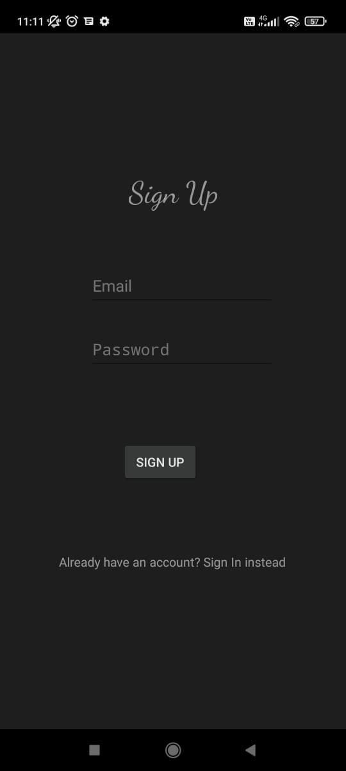
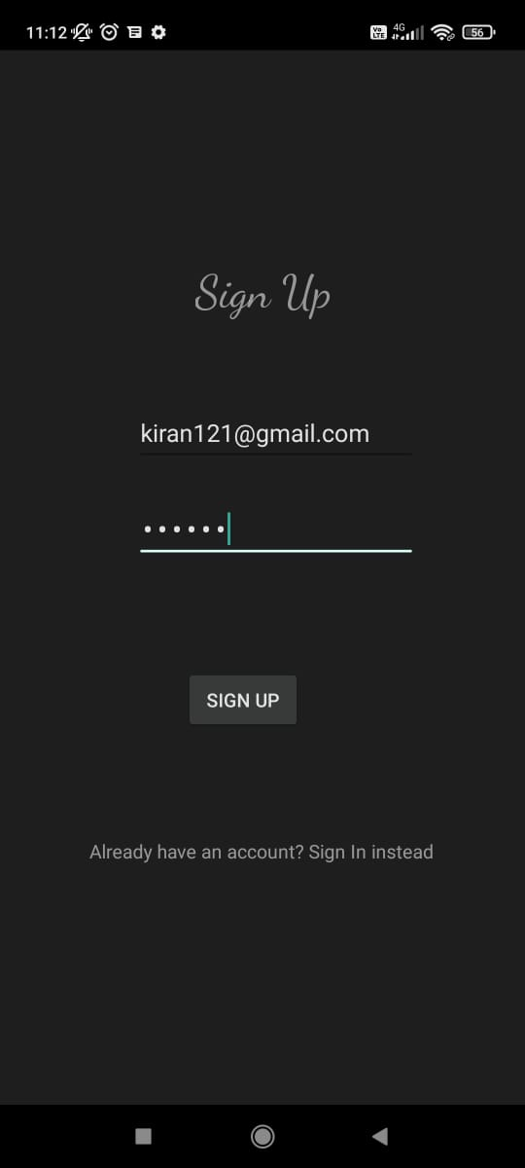
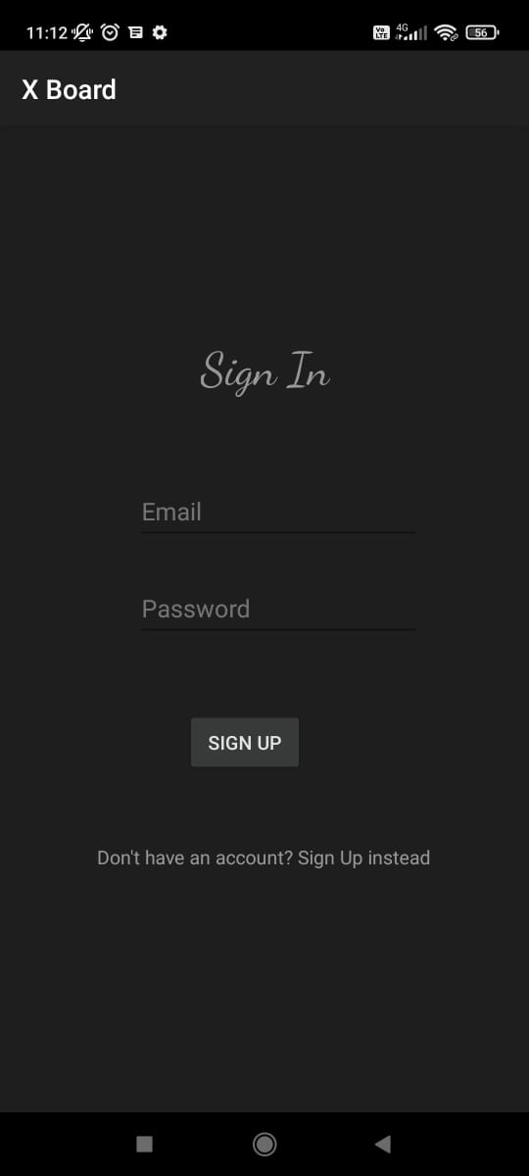
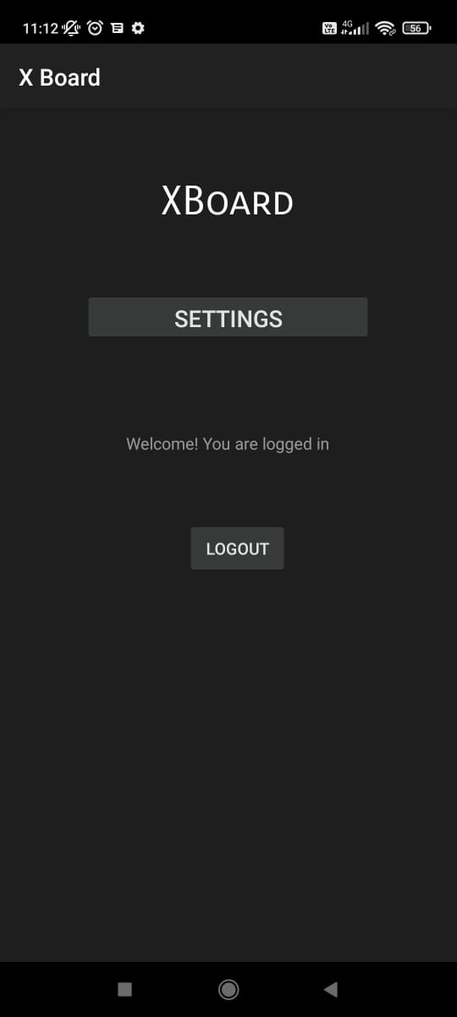
Implementation
‹#›

Slide 11
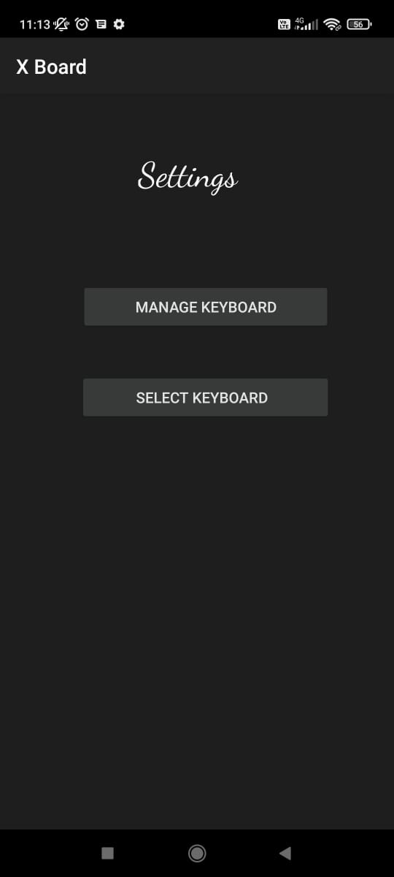
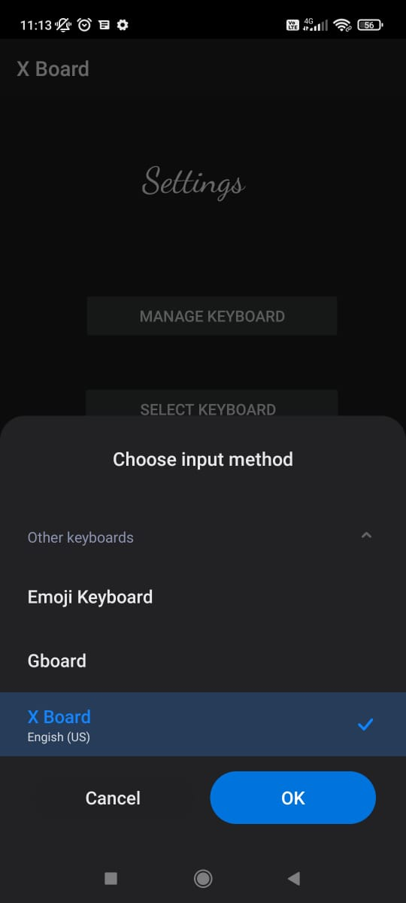
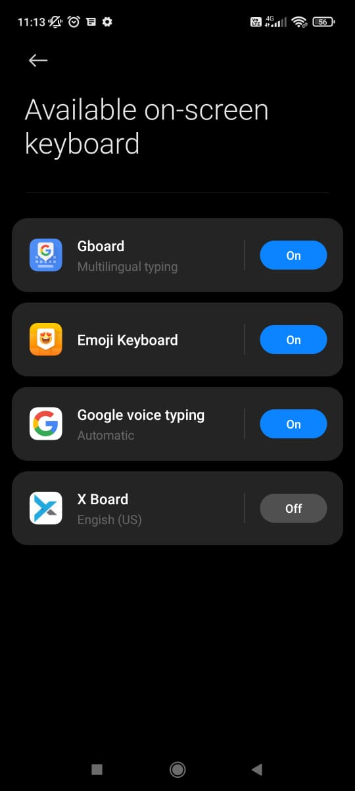
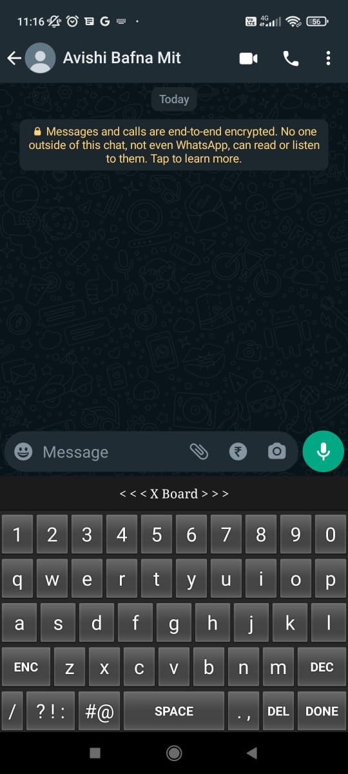
Implementation
‹#›

Slide 12
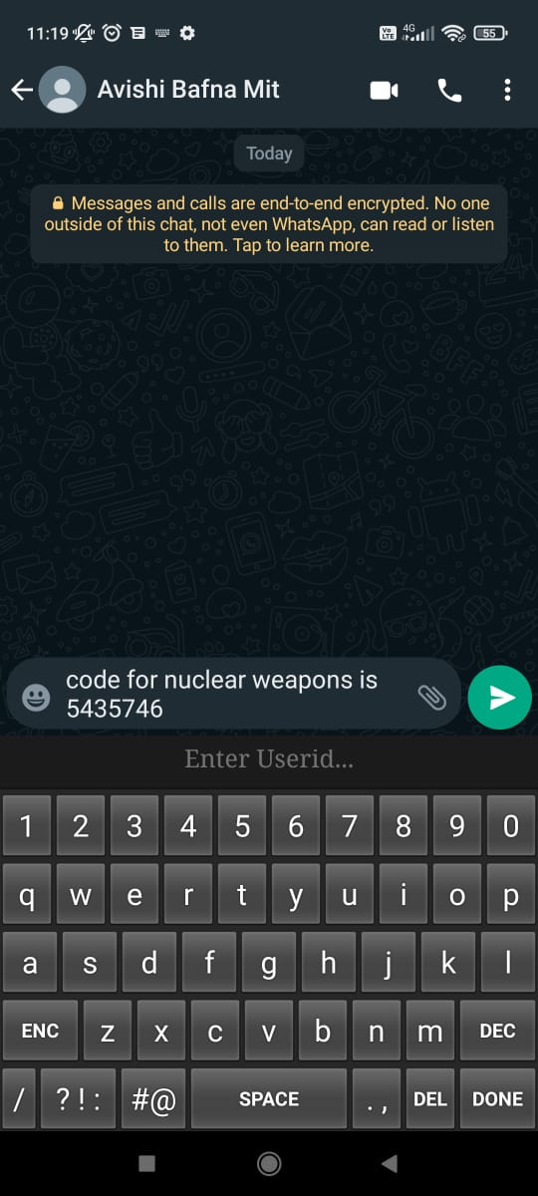
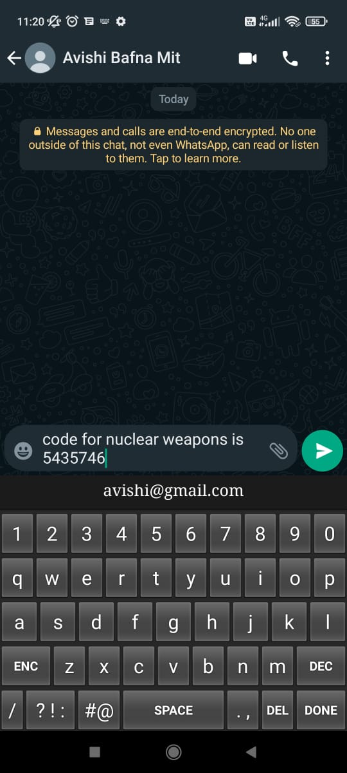
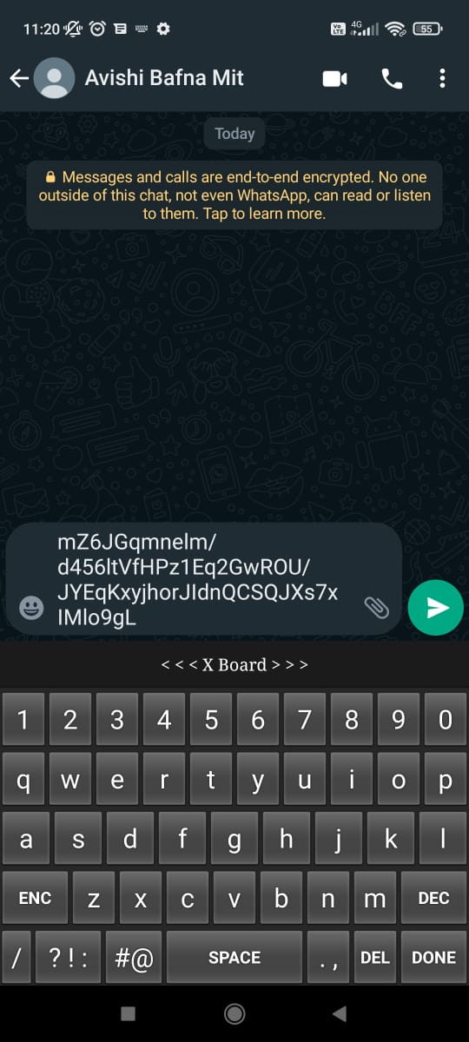
Implementation
‹#›

Slide 13
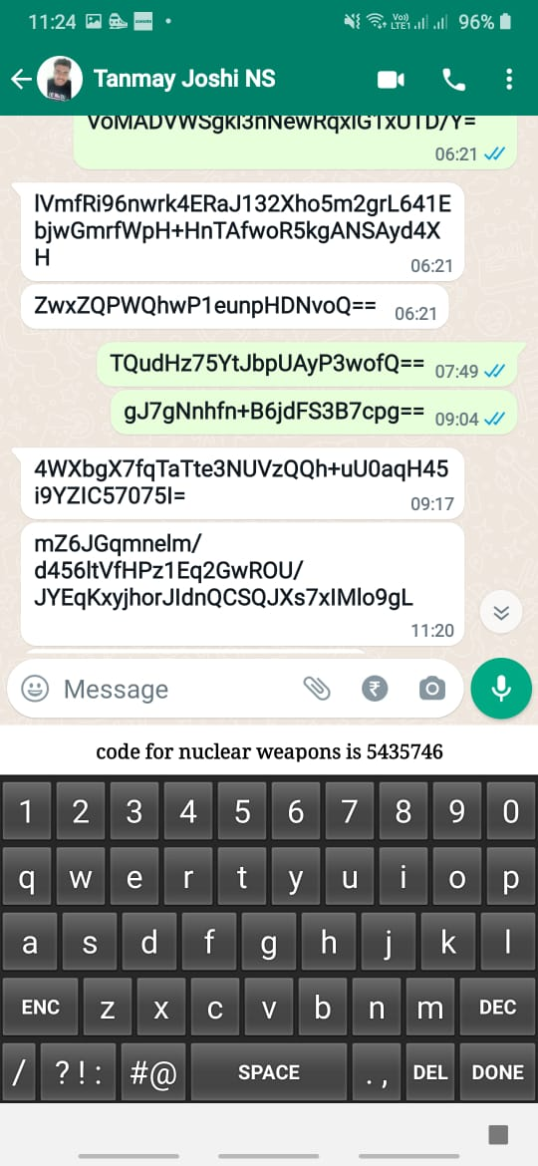
Implementation
‹#›

Slide 14
Future Scope
The high fidelity UI can be implemented to improve user experience.
Biometrics can be implemented to ensure the confidentiality of the message.
More option like vault and UPI payments can be implemented within the keyboard for enhanced usability.
Keystrokes can be ciphered to prevent spywares from tracking the confidential data and antispyware program can be implemented within the softboard.
‹#›

Slide 15
Conclusion
‘Xboard’ is an robust android application .
The key concept is to secure one’s integrity through a single android keyboard application using secure cryptographic algorithm.
The user with minimum knowledge about phones can be able to operate the application easily.
‹#›

Slide 16
THANK YOU
‹#›

